Slide 1


INTERACTIVE PORTFOLIO
Using Front-End Development
Name: Raj Santosh Khedekar
Register No.: 212402414
NMID: 2EF7C92FCAD297AB17C494E64A4FC796
Department: BCA
College/ University Name: AM Jain College

Slide 2



AGENDA
Project Overview
End Users
Tools and Technologies
Portfolio Design and Layout
Features and Functionality
Portfolio Outcomes
Conclusions & GitHub Links
Page 02

Slide 3


PROJECT OVERVIEW
Built using: HTML, CSS, JavaScript
Features Included:
Responsive navigation bar with mobile menu & dark mode toggle.
About Me, Skills, Projects, Contact sections.
Fully functional contact form.
Scroll-to-top button for smooth navigation.
Responsive web design.
Clean, modern with animations.
Page 03

Slide 4
END USERS
Who are the End Users ?
Potential Employers / Recruiters → to view your skills, projects, and contact you.
Teachers / Mentors → to evaluate your learning and progress.
Clients → who may want to see your work before hiring you.
Peers & Friends → for collaboration, feedback, or inspiration.
Designed for anyone interested in your skills, projects, and professional growth.
Page 04

Slide 5
TOOLS & TECHNIQUES
HTML → Structure of the website.
CSS → Styling, layout, responsiveness, animations.
JavaScript → Interactivity (dark mode, mobile menu, scroll button).
FormSubmit → Handling contact form submissions.
GitHub Pages → Hosting & deployment.
AOS Library → Smooth scroll animations.
Demonstrates use of modern web development tools and best practices in responsive design.
Page 05

Slide 6
DESIGN & LAYOUT
Clean & Modern UI → Minimalist, professional look with smooth animations.
Responsive Layout → Works seamlessly on desktop, tablet, and mobile.
Hero Section → Intro, tagline, and circular profile image.
About Section → Brief background & goals.
Skills Section → Highlights core technical skills (HTML, CSS, JS).
Projects Section → Showcases completed work with cards & links.
Contact Section → Simple form for easy communication.
Dark Mode Support → Improves accessibility & user experience.
Page 06

Slide 7
FEATURES & FUNCTIONALITY
Responsive Navigation Bar → Works on desktop & mobile (hamburger menu).
Dark Mode Toggle → Saves user preference with localStorage.
Skills & Projects Showcase → Display technical skills & work samples.
Contact Form → Integrated with FormSubmit for easy communication.
Scroll-to-Top Button → Smooth navigation back to top.
Animations → Fade, zoom & slide effects while scrolling.
Footer with GitHub Link → Quick access to your profile.
Ensures a user-friendly, interactive, and professional experience.
Page 07

Slide 8

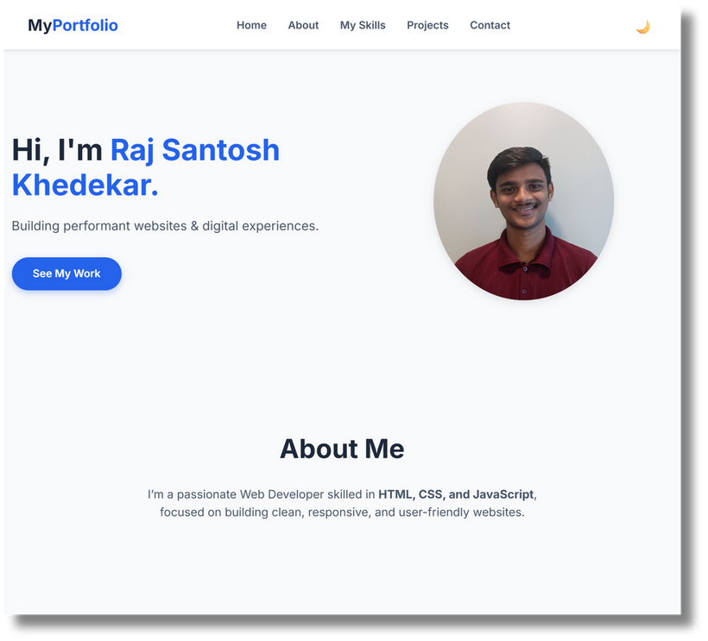
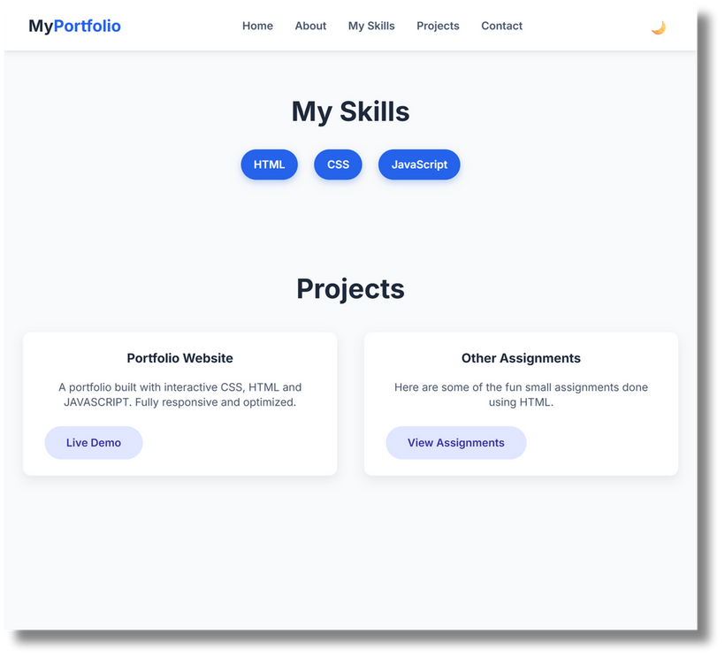

PORTFOLIO OUTCOME
Portfolio Result →
My portfolio
Page 08

Slide 9
CONCLUSION
Created a responsive, interactive portfolio website using HTML, CSS, and JavaScript.
Showcases personal skills, projects, and achievements in a professional way.
Integrated features like dark mode, animations, contact form, and mobile-friendly layout.
Demonstrates ability to apply modern web development practices.
Page 09

Slide 10

BENEFITS TO SOCIETY
Helps students & professionals present their skills digitally.
Makes it easier for employers and clients to discover talent.
Encourages others to build their own online presence.
GITHUB LINKS
Deployment Link →
Click Here
Server Link →
Click Here
Page 10

Slide 11
THANK
YOU
Presented by-
RAJ SANTOSH KHEDEKAR
24H218 | II BCA C

